Slide 1
Colorado Pizza Project
By Joshua Hiatt

Slide 2
Problem Statement
Find an Underserved Colorado Community with a Population of 100,000 or More w/o a local Pizzeria.
Recommend Local Favorites.
Create a Model to Predict Accurate Menu Pricing.

Slide 3
Data Sets
Pizza Data: https://www.kaggle.com/datasets/cid007/pizza-restaurants-us
City Data: https://simplemaps.com/static/data/us-cities/1.77/basic/simplemaps_uscities_basicv1.77.zip
County Demographic Data: https://www.kaggle.com/datasets/asaniczka/us-cost-of-living-dataset-3171-counties

Slide 4
Dataframe
Merged/Cleansed Dataframe: 21 Columns and 9002 Observations

Slide 5
Location

Slide 6
CO Favorites

Slide 7
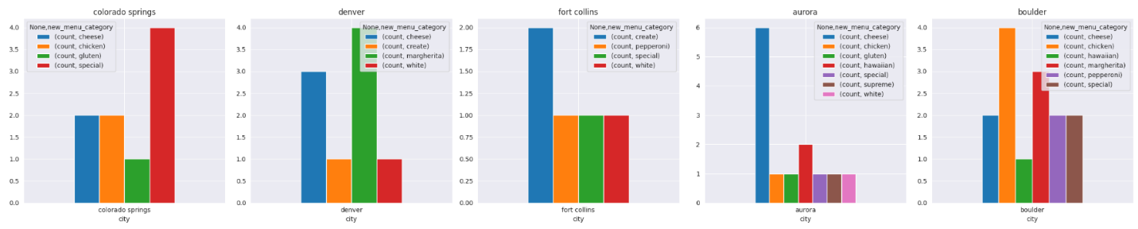
CO Town Favorites

Slide 8
Pizza Topping Correlations by US Town

Slide 9
Feature Engineering
Hawaiian
Greek
White
Taco
Sicilian
Meat
Lovers
Mini
BBQ
48 Optimized Clusters Created from Menu Item Description.
New Column Created Called ‘Category’.

Slide 10
Feature Engineering and Processing
Split Menu Item Column into Individual Words
One Hot Encoded Menu Item Words and Categorical Columns
Applied Standard Scaler to Numerical Columns
New Dataframe Shape was 4,948 Columns and 9002 rows
Bootstrapped Dataframe
Split Dataframe into Train and Test Sets

Slide 11
Models
XGBoost – Test R2: 0.595 / Test MAE $2.12
Random Forest Regressor – Test R2: 0.65 / Test MAE $2.35
AdaBoost – Test R2: 0.65 / Test MAE $1.86
Automated Feature Engineered – Test R2: 0.72 / Test MAE $2.07

Slide 12
THANK YOU

